Slide 1
Characteristics
Myeloma is a neoplasm of Ab-producing cells
Characteristics:
Immortal
HGPRT-
Nonproducing and nonsecreting Abs
The isolation of HGPRT- myeloma is easy because the E is coded for on the single active x chromosome present in each cell. A single mutation is required .
Selection of HGPRT- cells is carried out in the presence of the toxic 8-azaguanine or 6-thioguanine which are incorporated into DNA via HGPRT .
The cell line are readily available commercially
Internationally, The SP2/0-Ag14 or SP2 or NS-1 are commonly used murine
myeloma cells for hybridoma production while Lou/c is a rat cell line

Slide 2
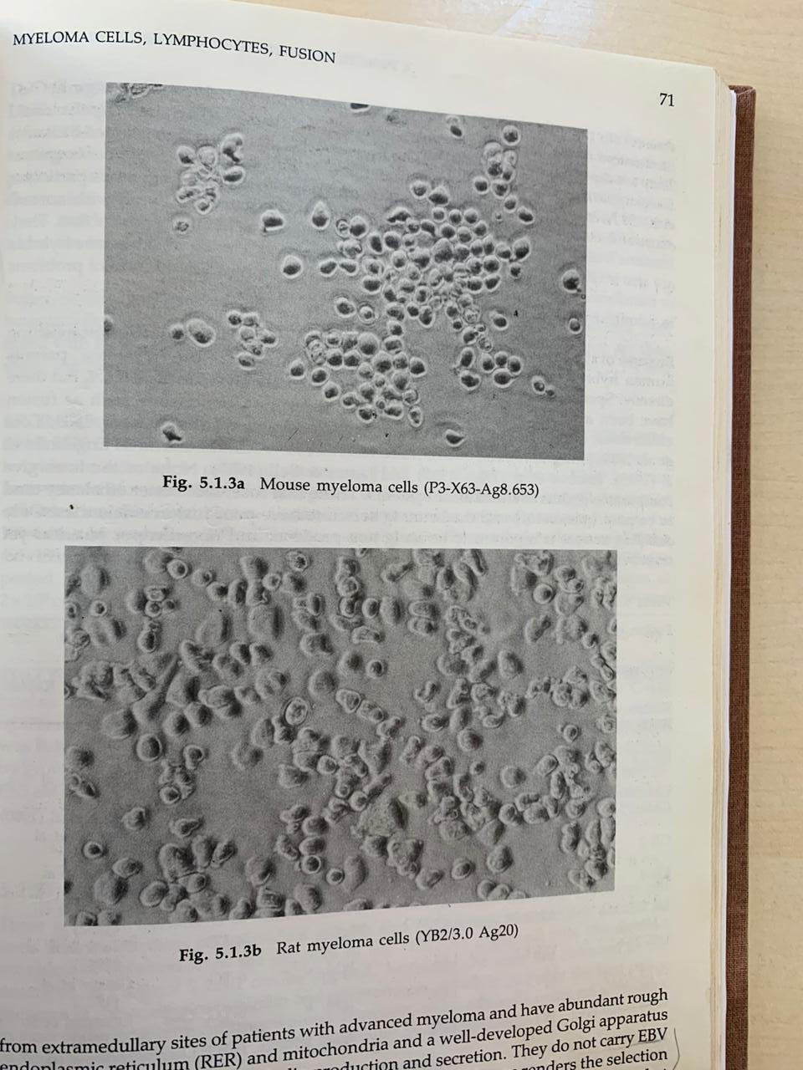

Slide 3
Human myeloma cells
The search is hampered by:
a. source of highly sensitized immune lymphocytes
b. human myelomas are difficult to establish in tissue culture
-have abundant RER, mitochondria and Golgi associated with high Ig production
-Do not carry EBV and are aneuploid
-doubling time in culture is about 70 hrs

Slide 4
Maintenance of Myeloma
50 ml in TC flask of complete media 10%FCS, 5% CO2, 37⁰C
Density 10⁵- 5x10⁶ cells/ml
Doubling time 12-18 h
Should be diluted in fresh medium and distributed to additional flasks
Medium should never be poured from the flask
It is inadvisable to maintain myeloma cells in culture indefinitely since they are prone to spontaneous mutations and revert to HGPRT+. The cells should be grown periodically in media containing 6-TG or 8-AG. HGPRT- Will be unaffected but any HGPRT+ die

Slide 5
Counting Myeloma cells
Using hemocytometer slide or cell counter
Count all the cells in each of the 4 large corner squares. The total is divided by 4 to obtain the mean number
53+ 51 + 47 +49/4 =50
50 x 10⁴= 5 x 10⁵ cell/ml

Slide 6
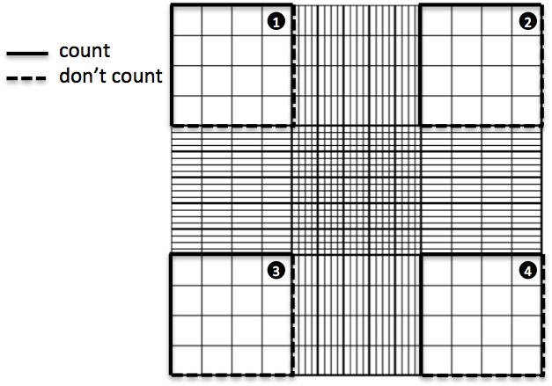

Slide 7
Viability test
Using trypan blue stain
Disadvantage: rapidly taken by viable cells within 10 min
Have great affinity to proteins so elimination of serum from the cell diluent would give greater accuracy
Storage of cells
Density: 2-10⁶ cells in 0.25 ml freezing medium/cryotube
Freezing medium Glycerol or 4%DMSO +96%FCS
Place in polystyrene box in -80⁰C immediately and transfer to L N2 within 24 h
Thawing
Thaw cryotube quickly in 56⁰C waterbath
Dilute gradually with cold media
Centrifuge and suspend pellet in warm thymocyte media and transfer to 24-well plate

Slide 8
Basic tissue culture (subculturing)
https://www.youtube.com/watch?v=CMRKKl9XSDU
Freezing cells
https://www.youtube.com/watch?v=tCNtKrxlZPs
Thawing cells
https://www.youtube.com/watch?v=4HxqQOHifkU

